Slide 1
Simultaneous Localization And Mapping
Robotics Project
Team D
11/26/19

Slide 2
Problem definition

Slide 3
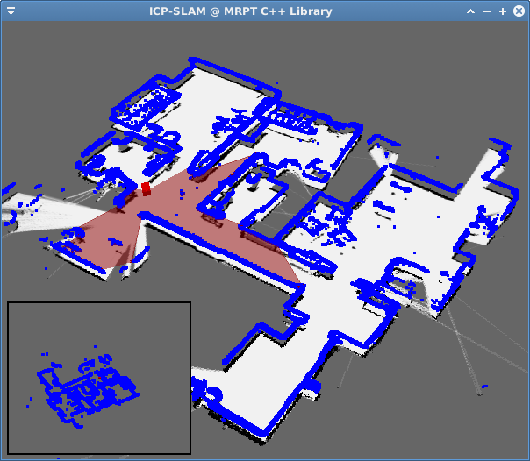
SLAM
Localization
Map Construction

Slide 4
Mechanics and electronics

Slide 5
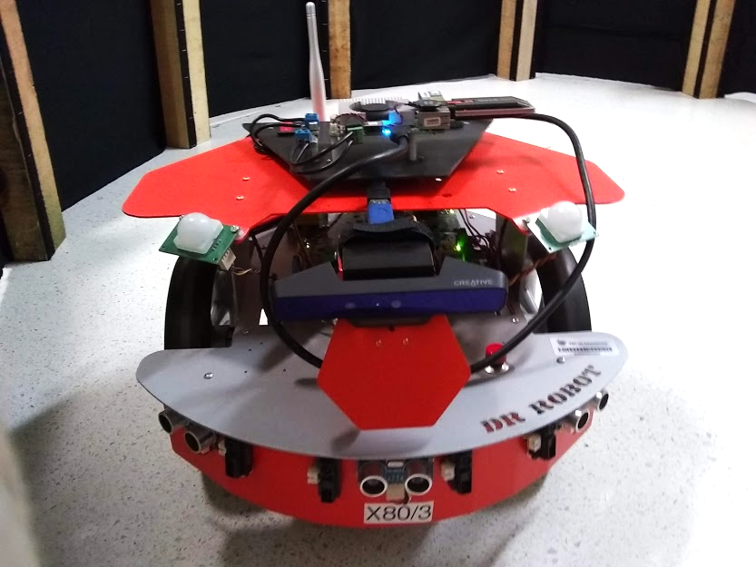
The robot: DrRobot X80
Differential drive - 2 DC motors with encoders
IR sensors (7)
Ultrasonic sensors (3)
Pyro sensors (2)
Wireless module
Three decks for equipment

Slide 6
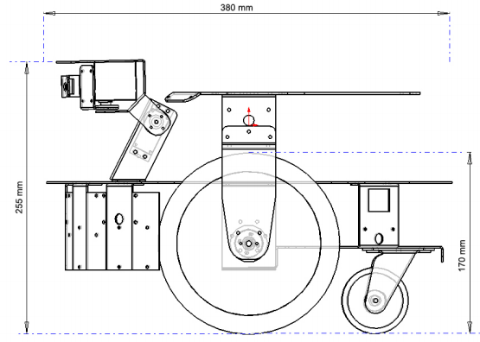
Mechanical specifications
Weight: 3.5 kg
Diameter: 38 cm
Height: 25.5 cm
Two DC motors with 22 kg·cm torque each
Maximum linear vel: 1 m/s
Minimum linear vel: 0.05 m/s
Maximum angular vel: 2 rad/s
Minimum angular vel: 0.1 rad/s
Wheel radius: 8.55 cm
Distance between wheels: 28.7 cm

Slide 7
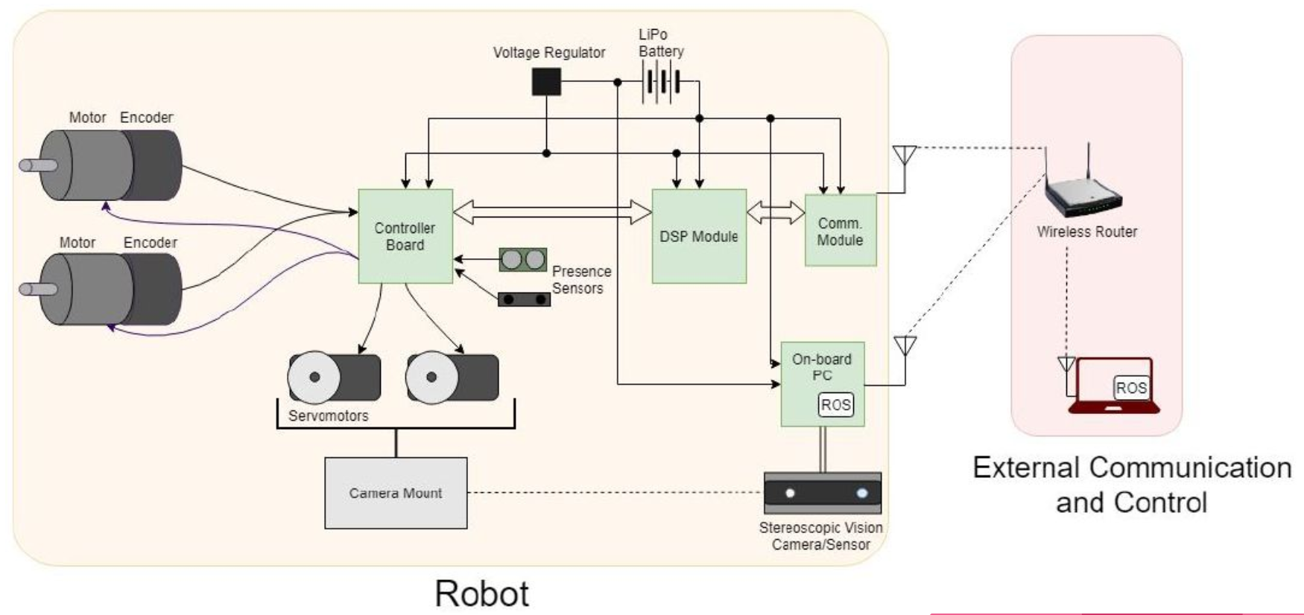
Subsystems and interfaces

Slide 8
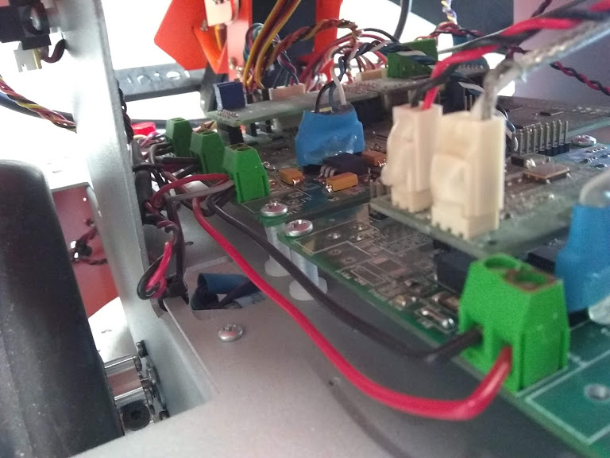
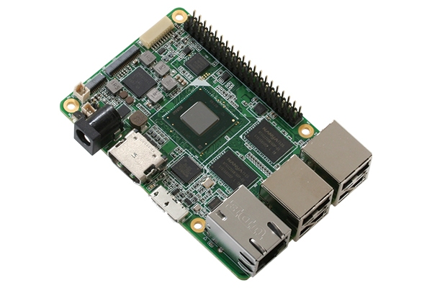
Electronics
800mA @ 5VDC
4A @ 5VDC

Slide 9
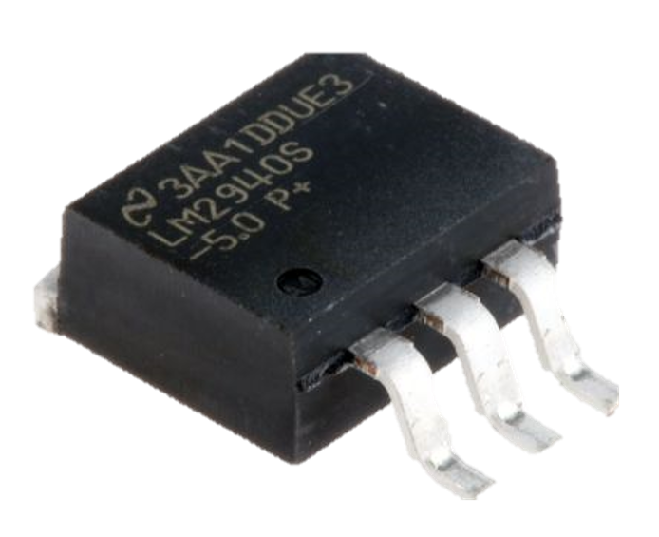
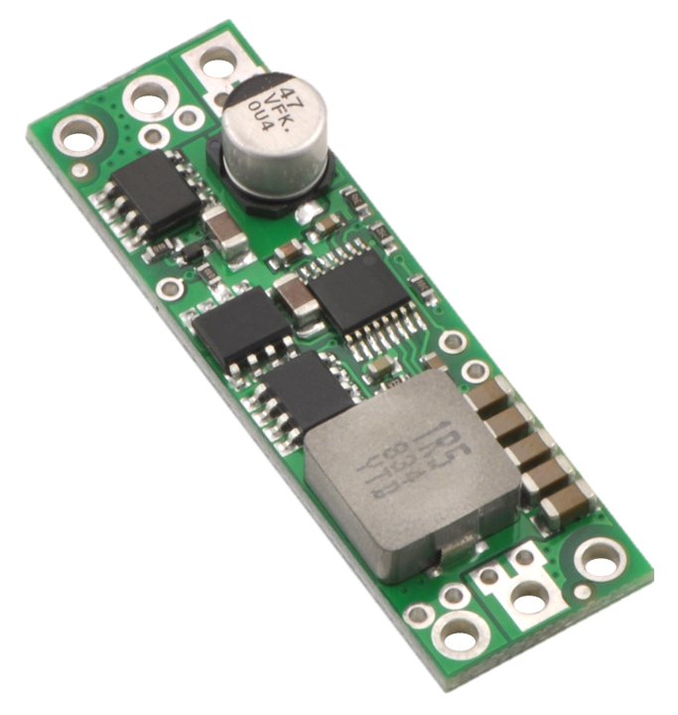
Electronics
D15V70F5S3
Input
4.5V - 24V DC
Output
5V DC
Up to 7A
LM2940S
Input
6V - 26V DC
Output
5V DC
Up to 1A

Slide 10
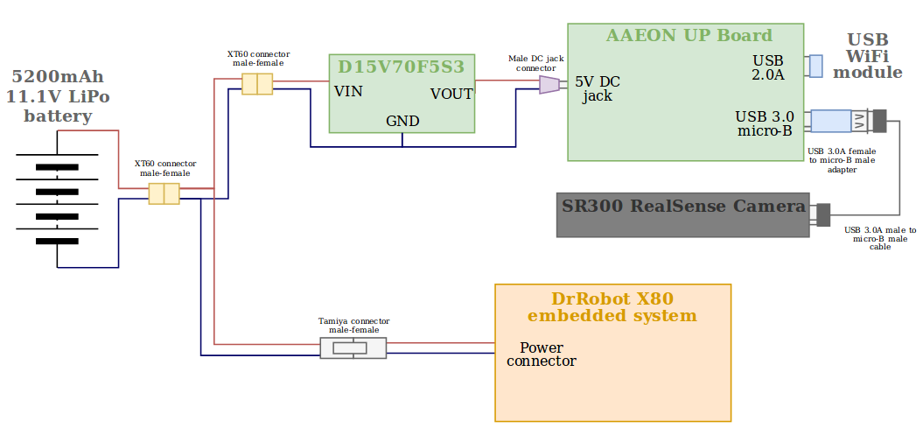
Electronic diagram

Slide 11
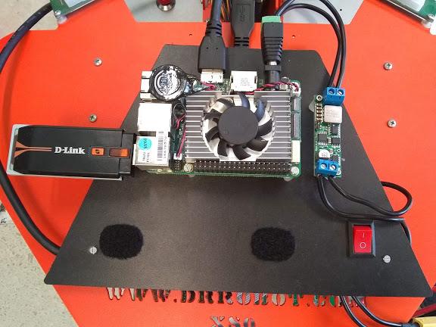

UP Board
85.6mm x 56.5mm
1.44 GHz
2 GB RAM
Ubuntu 16.04
D-Link USB WiFi module
One USB 3.0 port

Slide 12
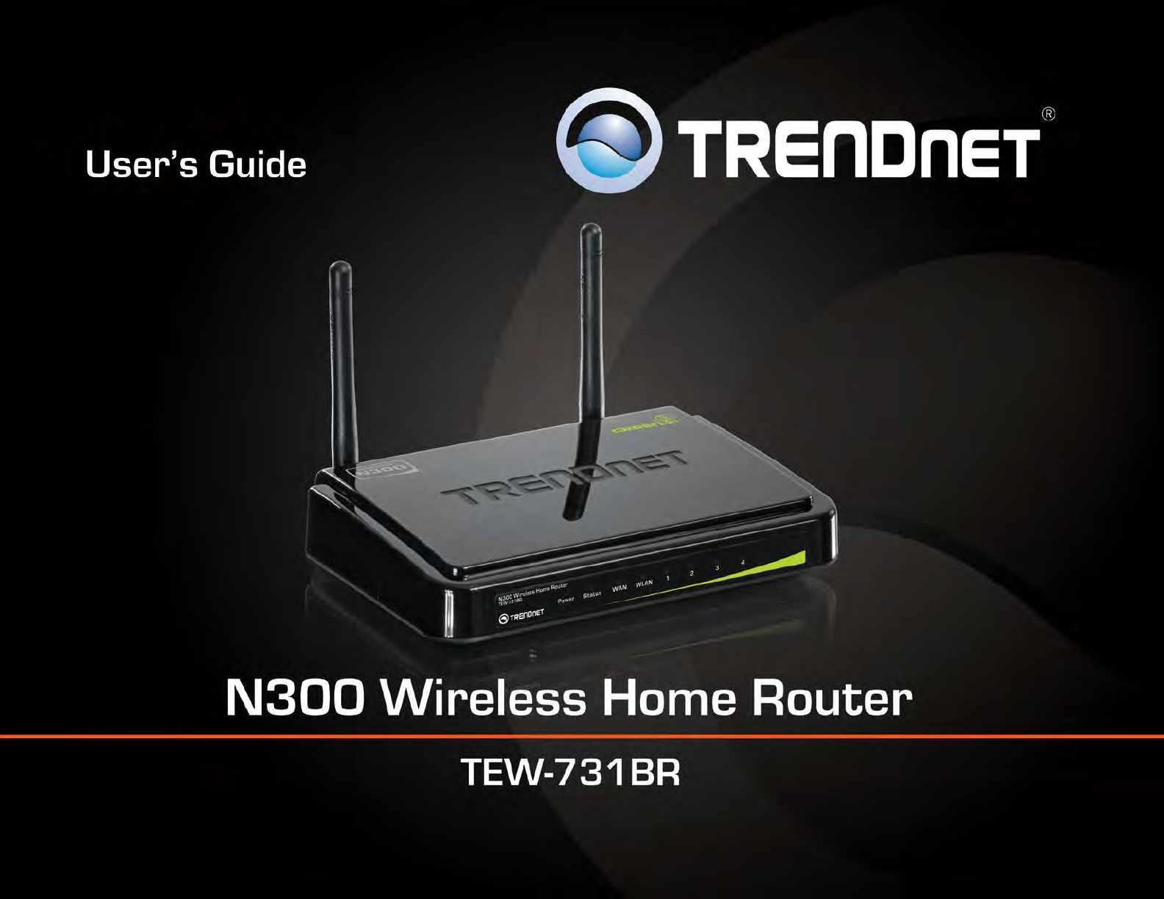
Wireless Communication
Private LAN with fixed IP addresses:
X80: 192.168.0.203
UP Board: 192.168.0.103
SSID: dri
X80 communication module is preconfigured and protocol is fixed

Slide 13
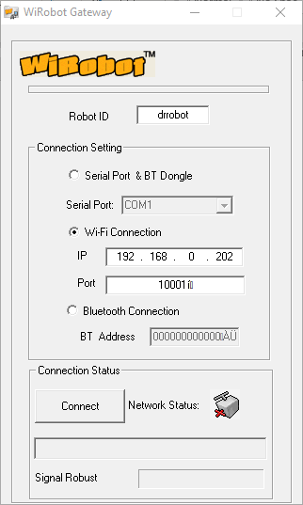
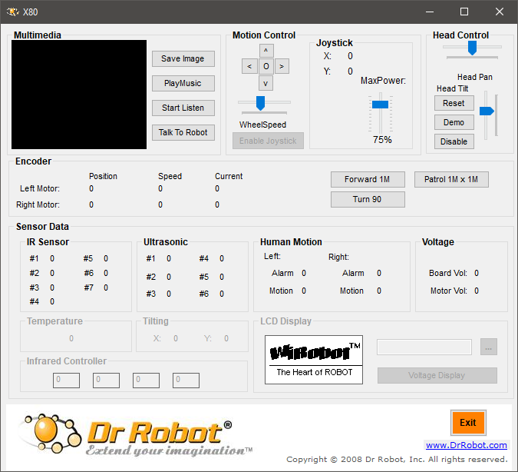
Wireless Control - First approach

Slide 14
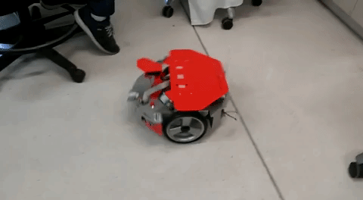
Wireless Control - First approach

Slide 15
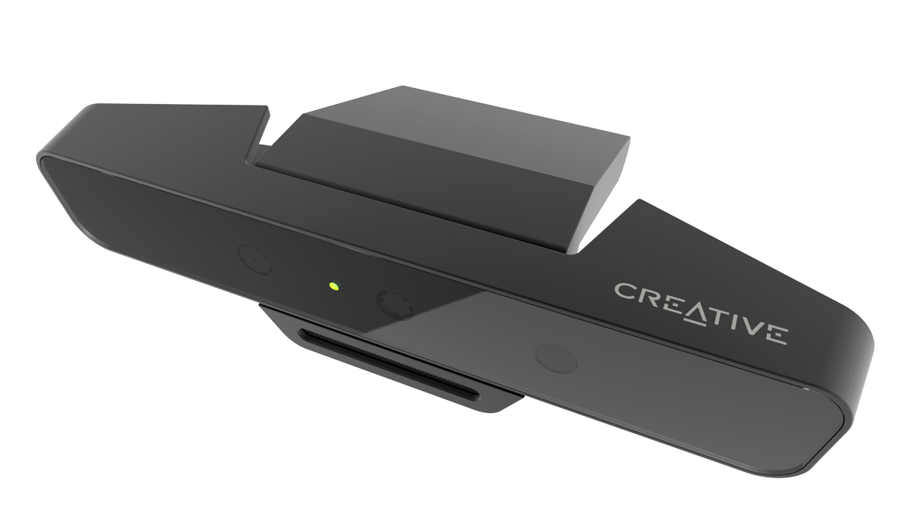
RGB-D sensor
INTEL REALSENSE SR300
Color and depth images are used to determine pointcloud data
Pointcloud: a set of data points in space which represent the external surfaces of objects around the sensor

Slide 16
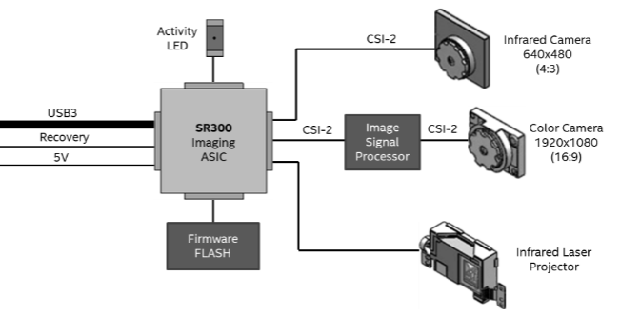
RGB-D sensor
Not used
640x480p @ 10 fps
640x480p @ 10 fps

Slide 17
Software

Slide 18

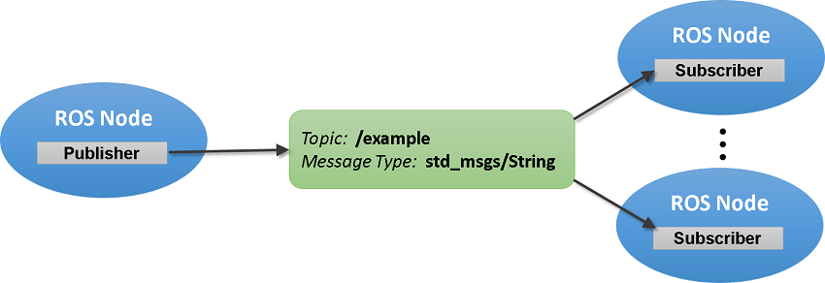
ROS nodes and topics
Image retrieved from: https://www.mathworks.com/help/ros/ug/exchange-data-with-ros-publishers-and-subscribers.html

Slide 19
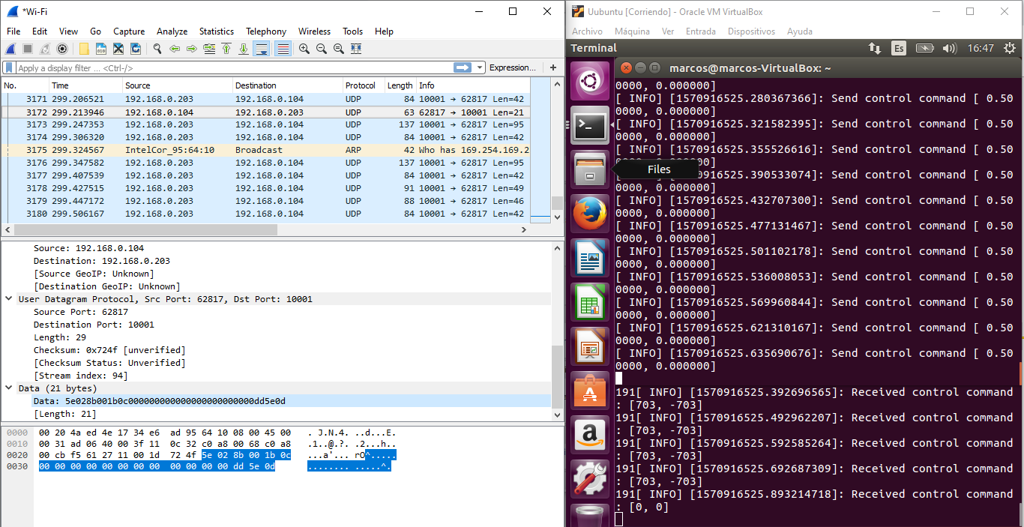
Remote Control through ROS

Slide 20
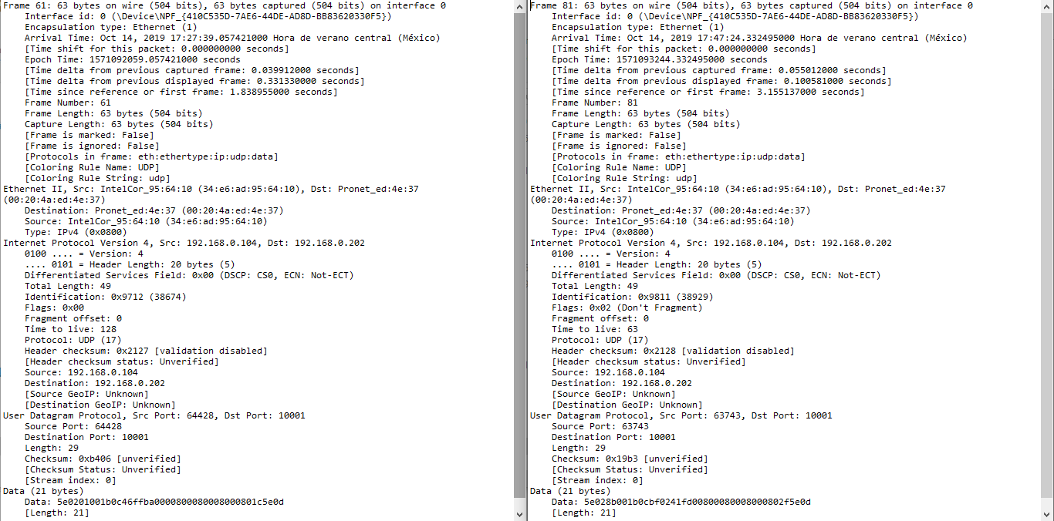

Slide 21
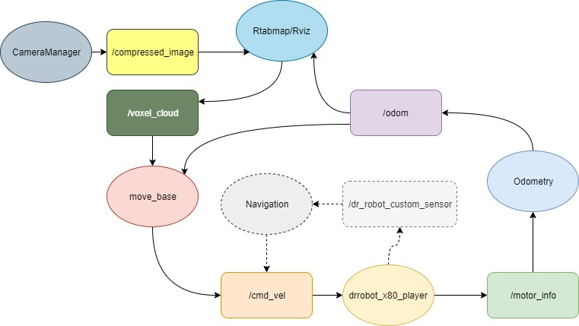
ROS - Software design

Slide 22
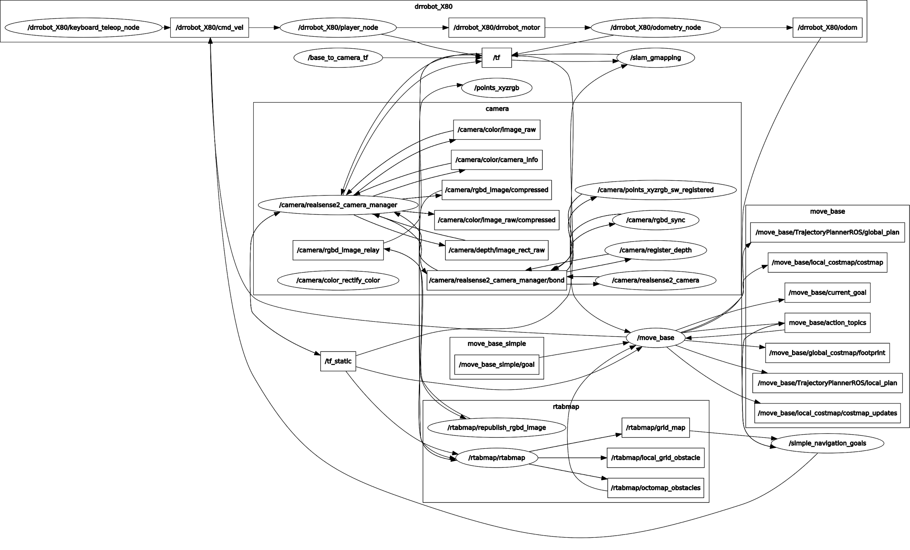
Runs on on-board PC
Runs on external PC
rqt_graph

Slide 23
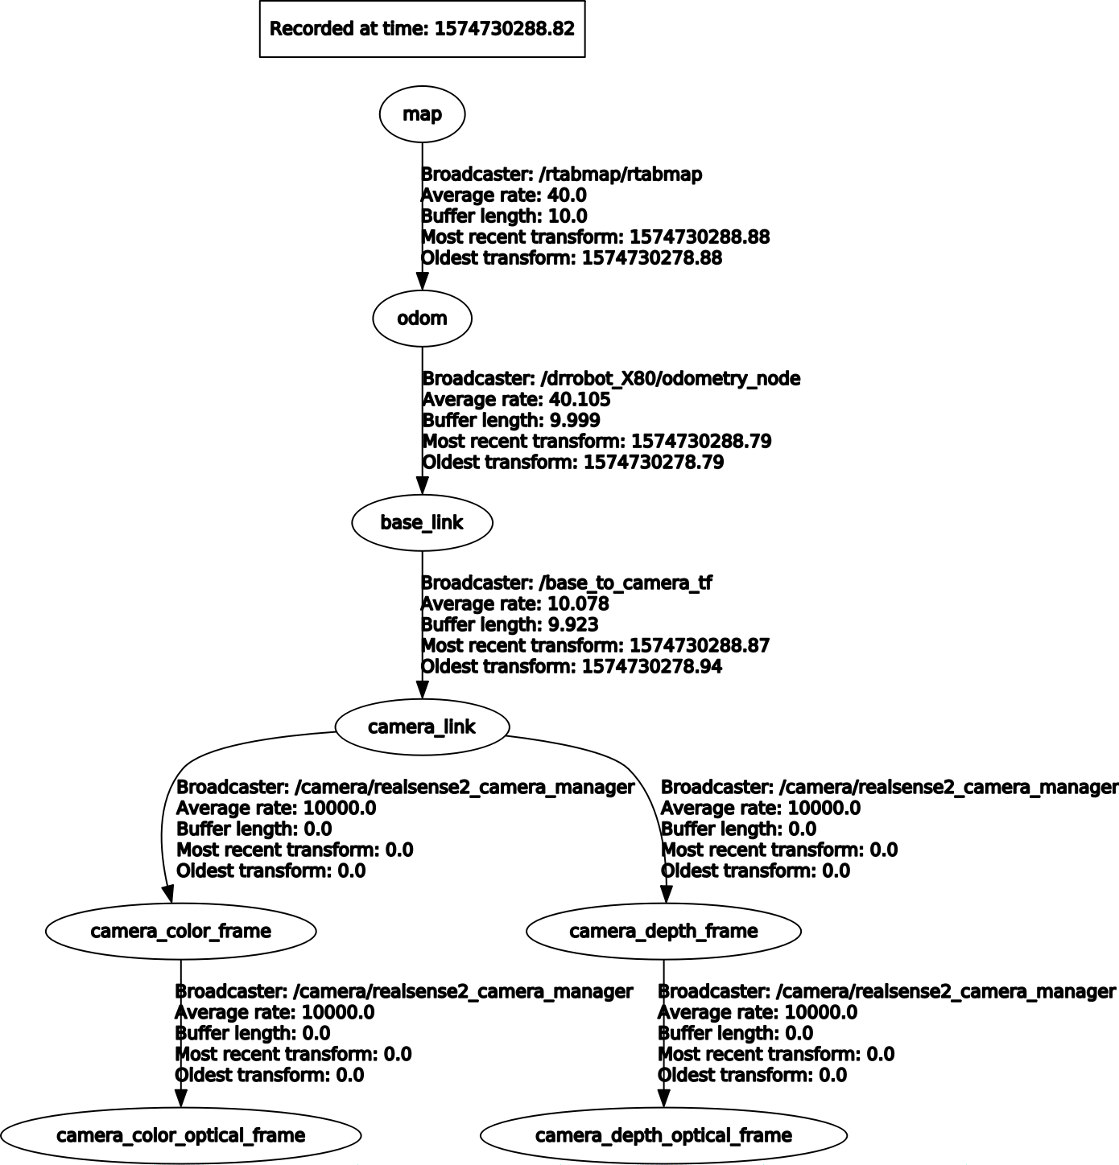
rqt_tf_tree

Slide 24
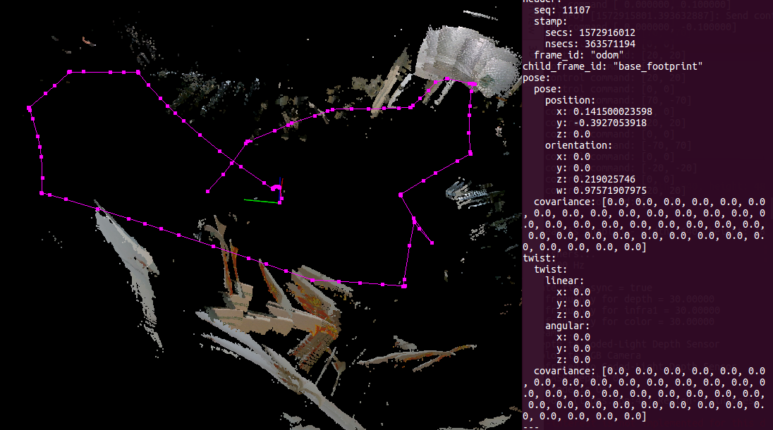

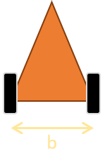
Odometry
Encoder-only odometry: 12 to 40 cm error from origin

Slide 25
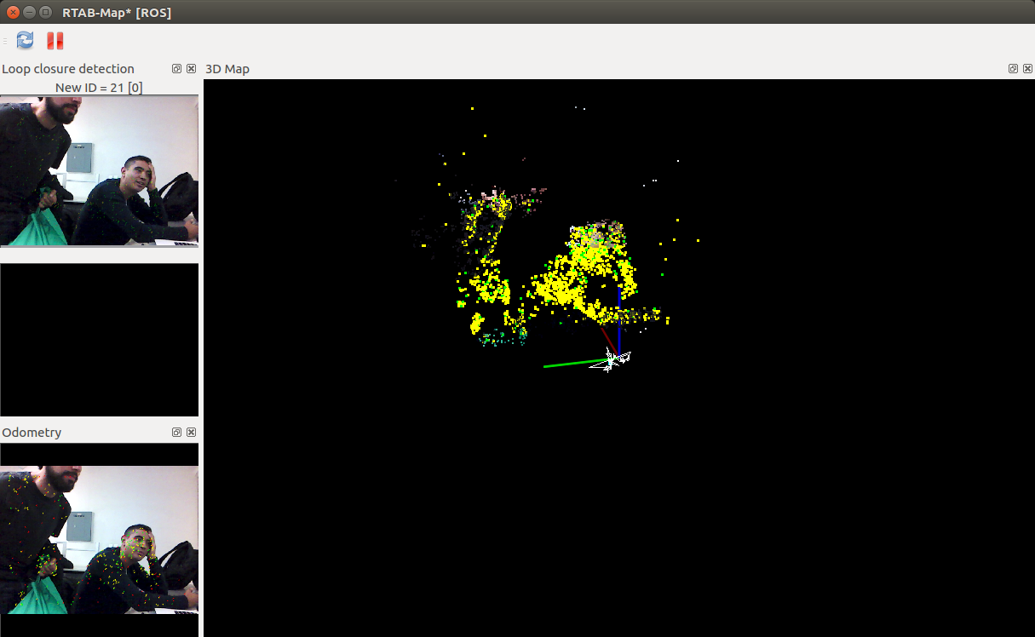
Point Cloud Obtention

Slide 26
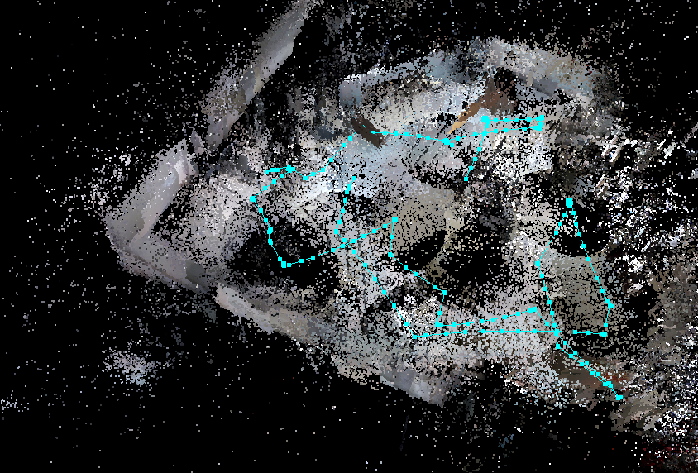
Cloud Map using Intel Realsense R200

Slide 27
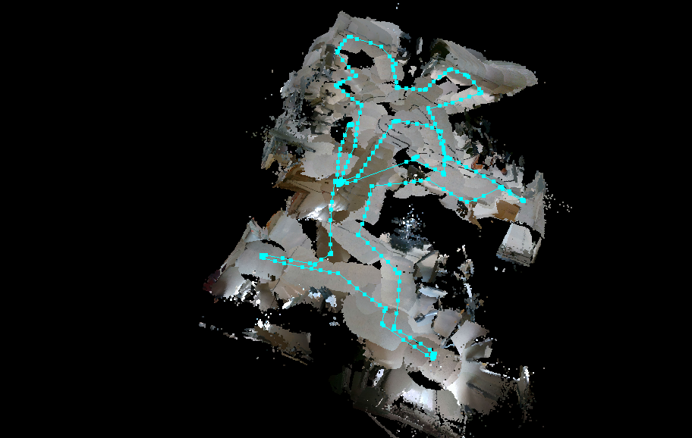
Cloud Map using Intel Realsense SR300

Slide 28
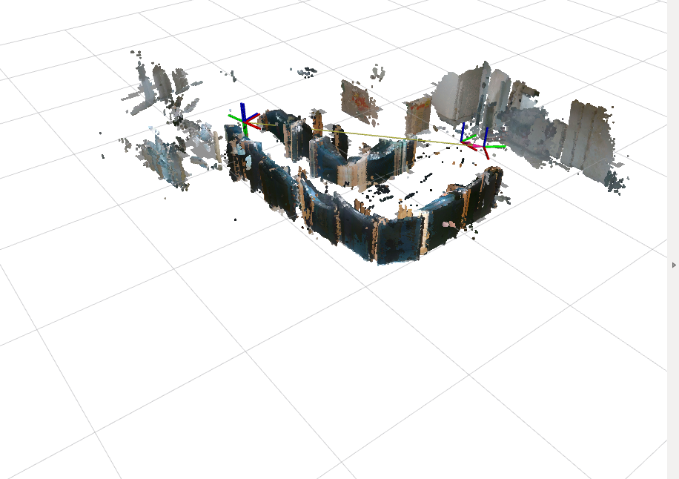
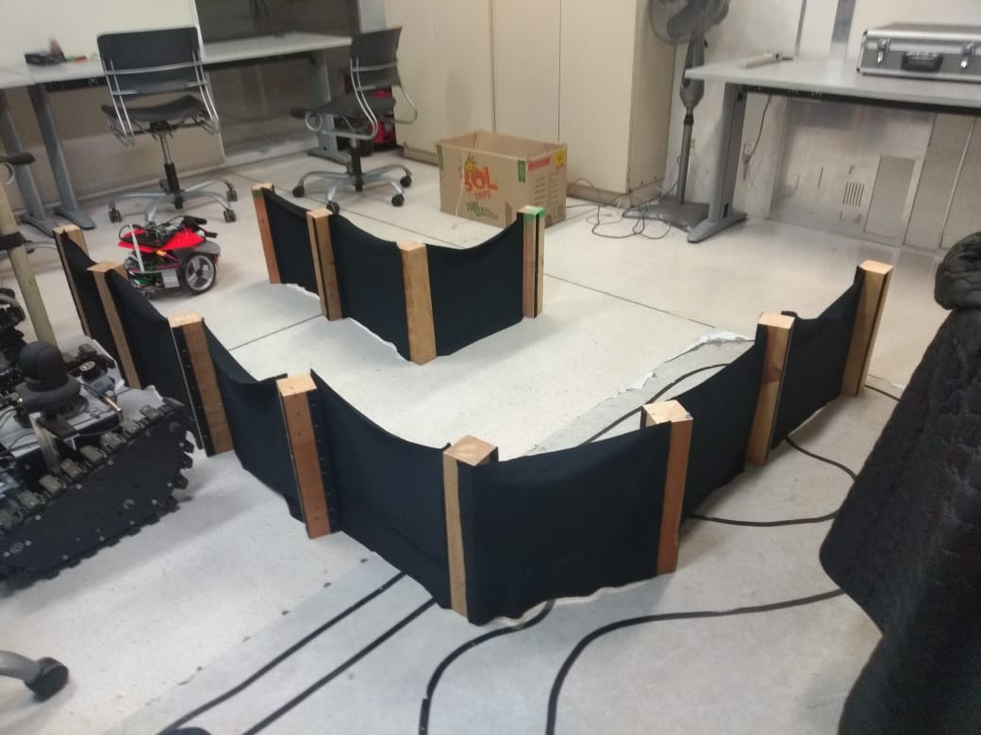
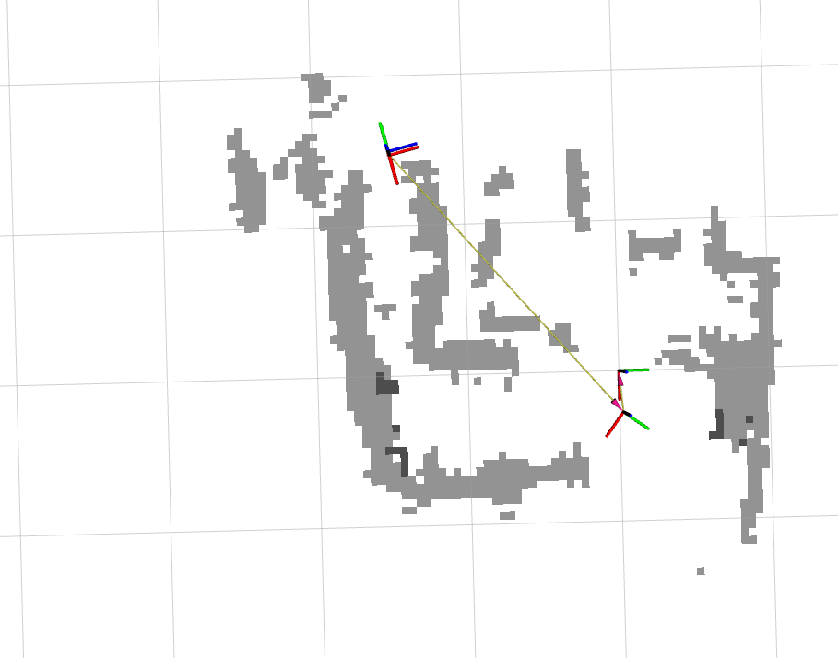
2D and 3D obstacle detection

Slide 29
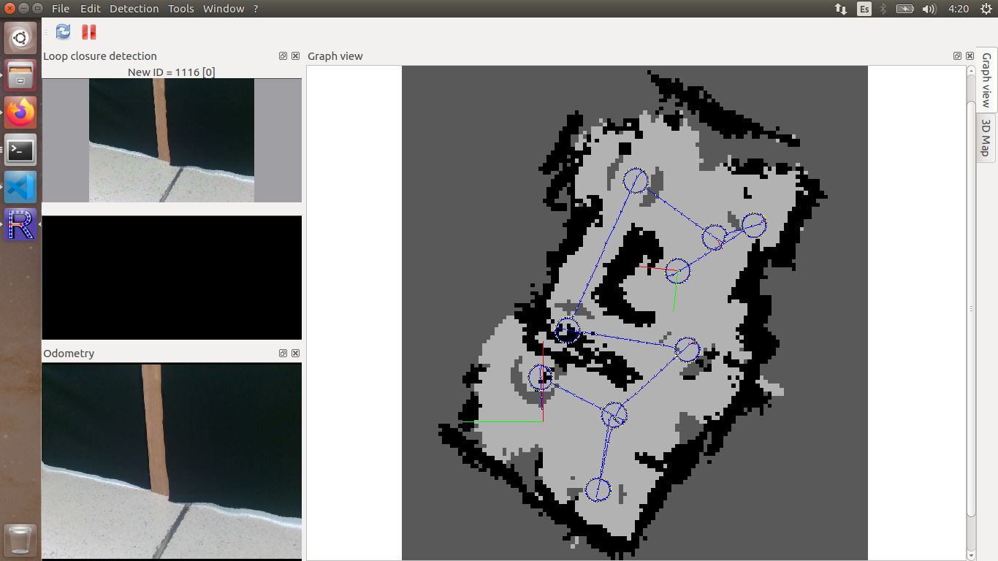
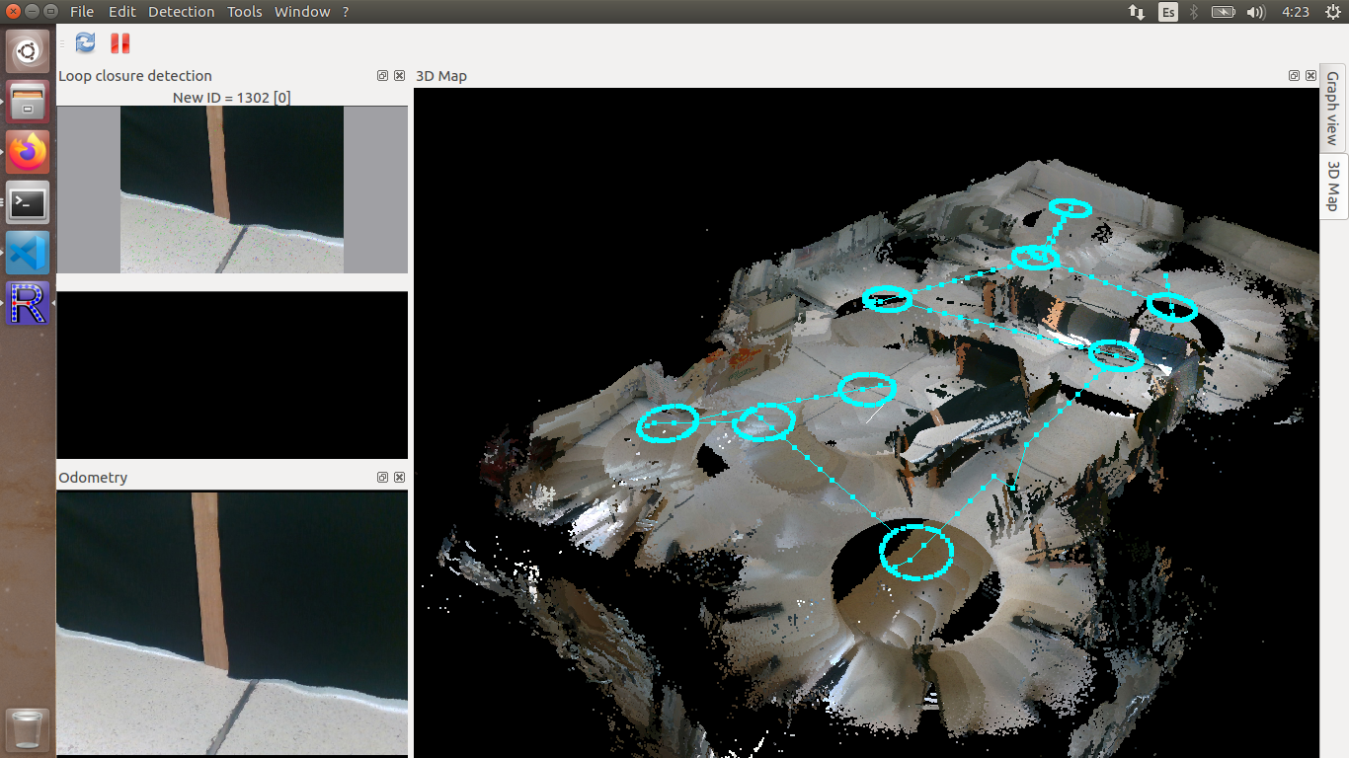
2D and 3D mapping (with loop closure)

Slide 30
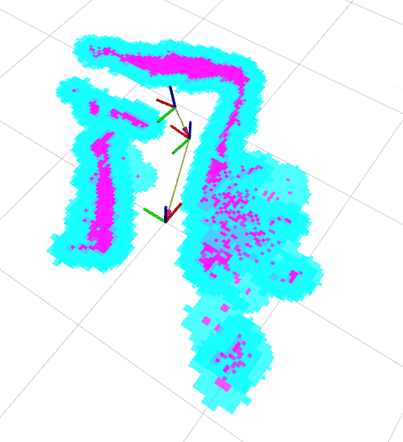
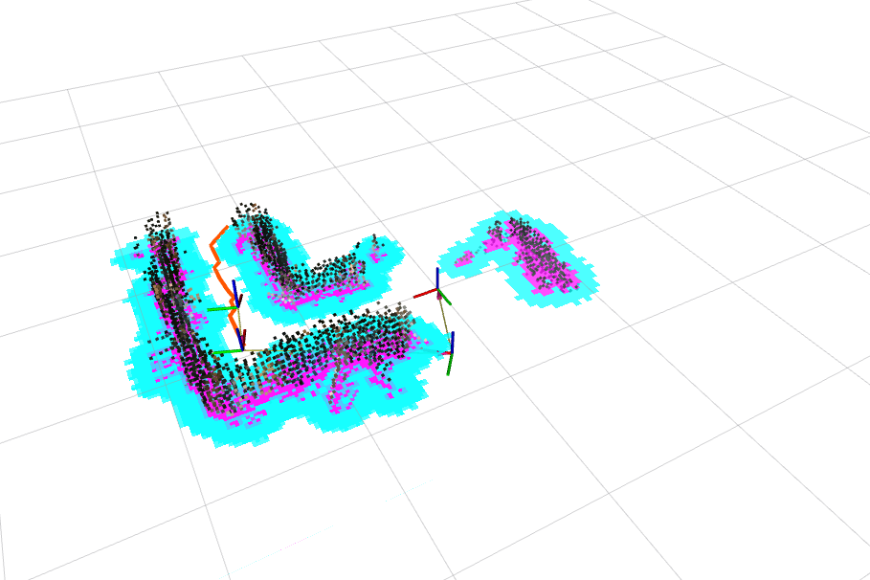
Costmap Construction

Slide 31
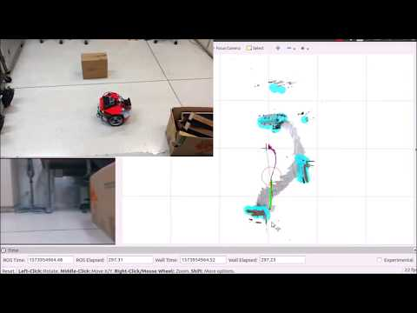
Manual Goals

Slide 32
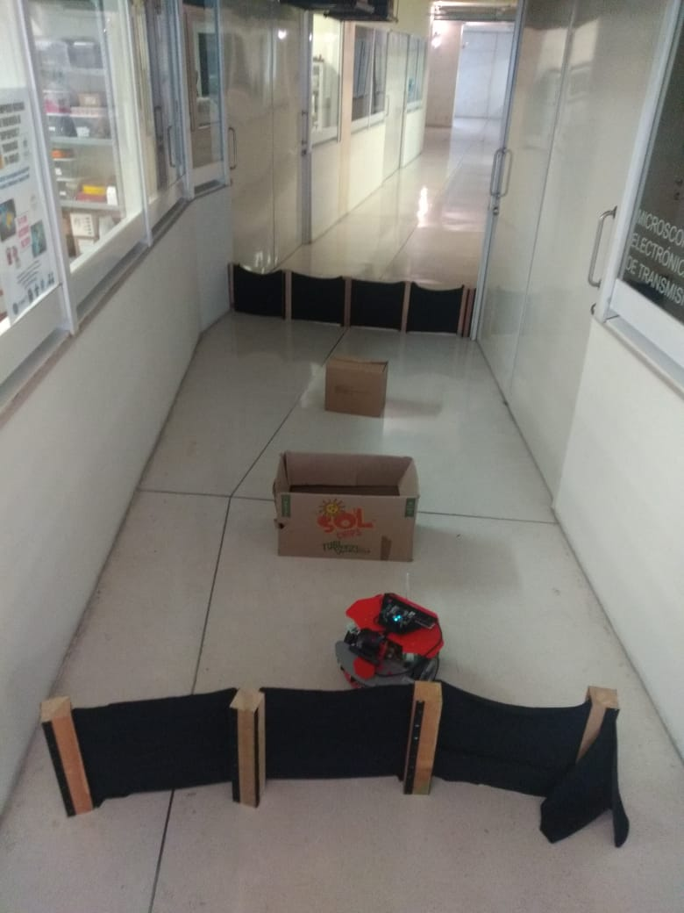
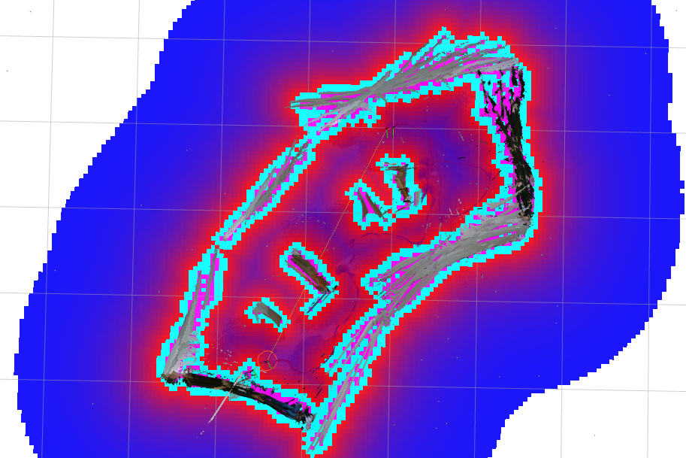
Autonomous goal - infinity

Slide 33
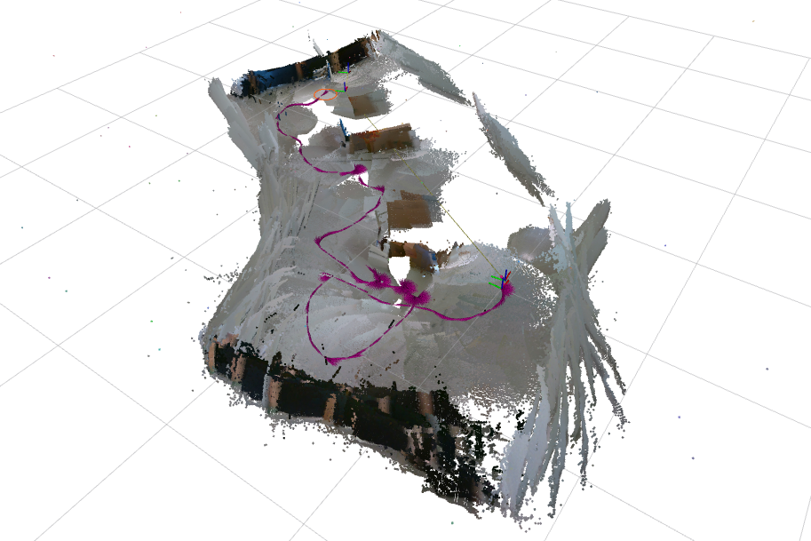
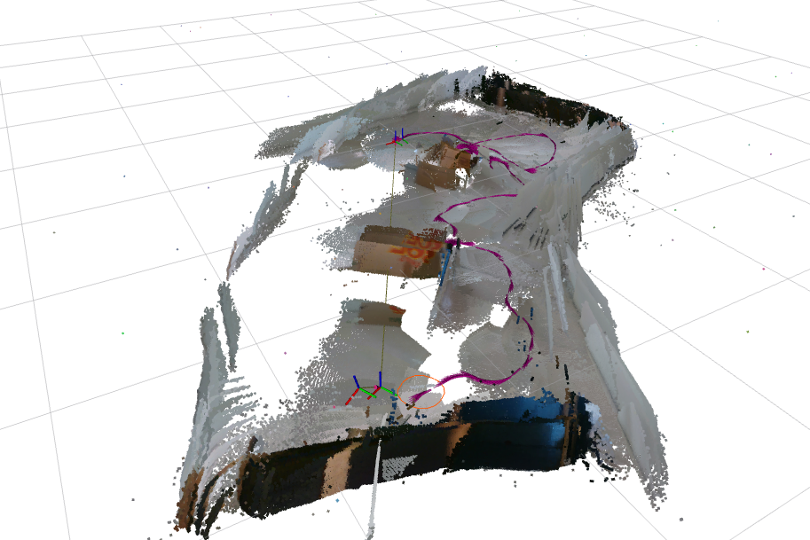
Autonomous goal - infinity

Slide 34
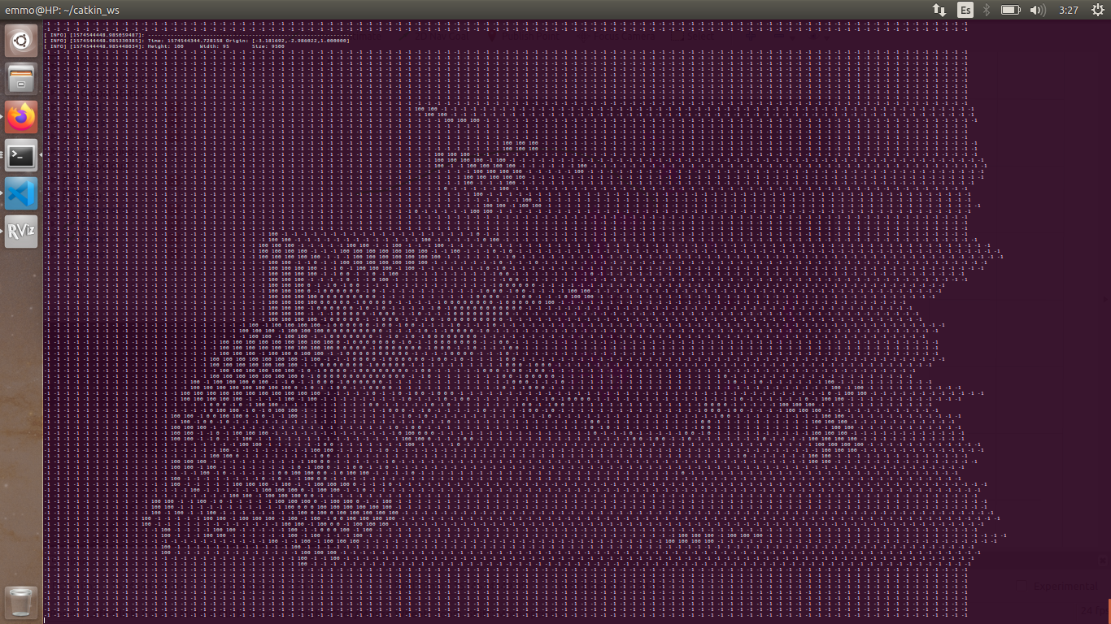
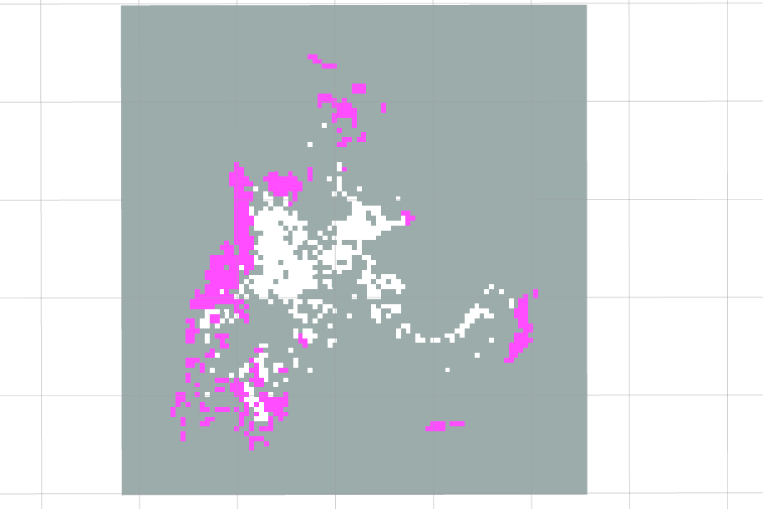
Grid Map as a matrix
Notes:
Tiene una animación. No es que solo se vea feo

Slide 35
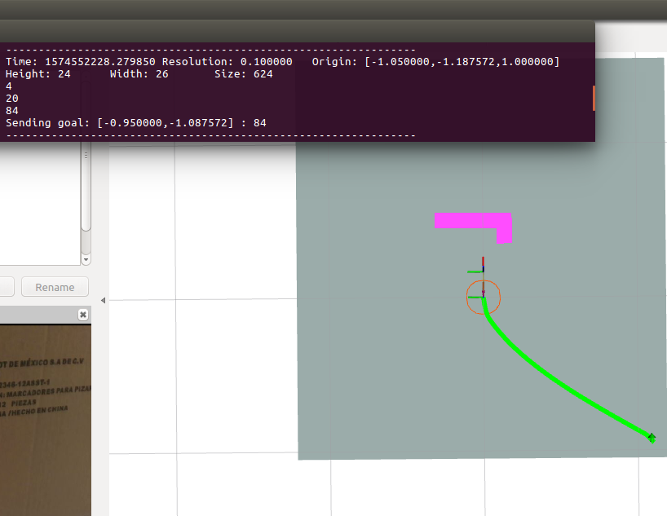
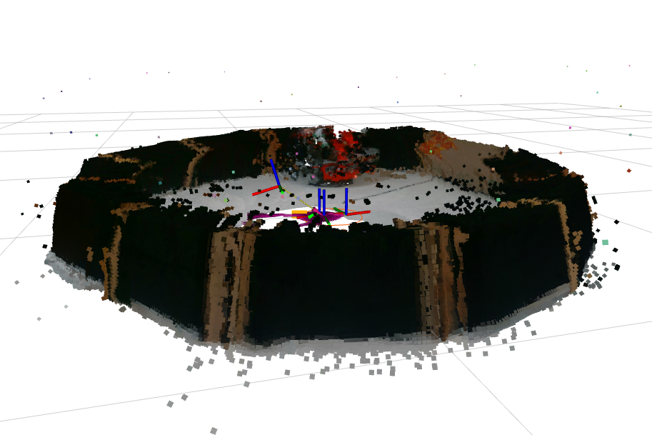
Autonomous goal - Operations on matrix
Unexplored clusters
Nearest, minimum radius

Slide 36
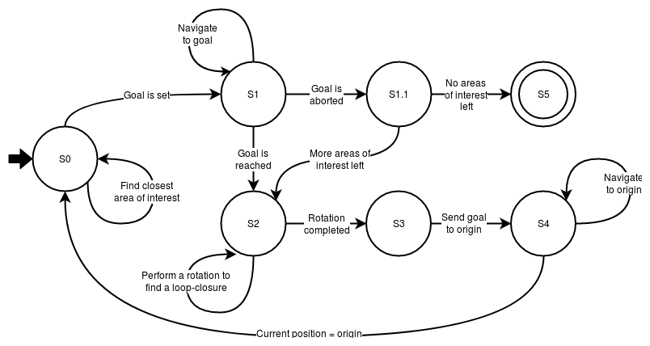
Final autonomous behavior

Slide 37
Demo

Slide 38
References
[1] Intel Corporation. (2016). ​​BlasterX Senz3D User’s Guide​. Retrieved from: https://download.creative.com/manualdn/Manuals/TSD/13681/0x25D74F59/BlasterX%20Senz3D_UG_EN.pdf
[2] Dr. Robot. (2006). ​​Wi Robot X80 USER MANUAL​​. Retrieved from: https://www.cs.princeton.edu/courses/archive/fall11/cos495/X80_Manual.pdf
[3] AAEON. (2019). ​​UP Datasheet V8.5​​. Retrieved from: http://data-us.aaeon.com/DOWNLOAD/2014%20datasheet/Boards/UPDatasheetV8.5.pdf
[4] Pololu Corporation. (2019). ​​Pololu Step-Down Voltage Regulator D15V70F5S3​​. Retrieved from​: ​https://www.pololu.com/product/2111/specs
[5] Texas Instruments. (2014). ​LM2940x1 - A Low Dropout Regulator​. Retrieved from: http://www.ti.com/lit/ds/symlink/lm2940-n.pdf
[6] Open Source Robotics Foundation. (2019). ​rtabmap_ros​. Retrieved from: http://wiki.ros.org/rtabmap_ros/
[7] ​Idem​. (2017).​ tf_ros. ​Retrieved from: ​http://wiki.ros.org/tf
[8] ​Idem​. (2019). ​navigation​. Retrieved from:​ http://wiki.ros.org/navigation/

Slide 39
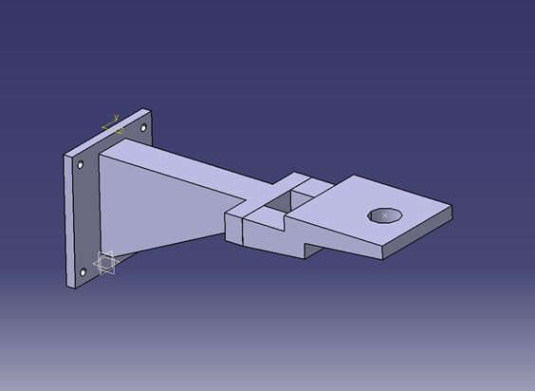
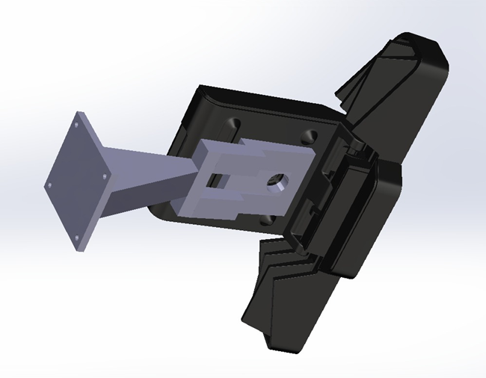
Notes:
(Sorry)

